Slide 1


Real Estate Case Study: -Chicago, IL-
Group 2: Omar Ahmed, Asif Rashid, Tyler Dale, Trevor Soule, Francesca Mirthil

Slide 2
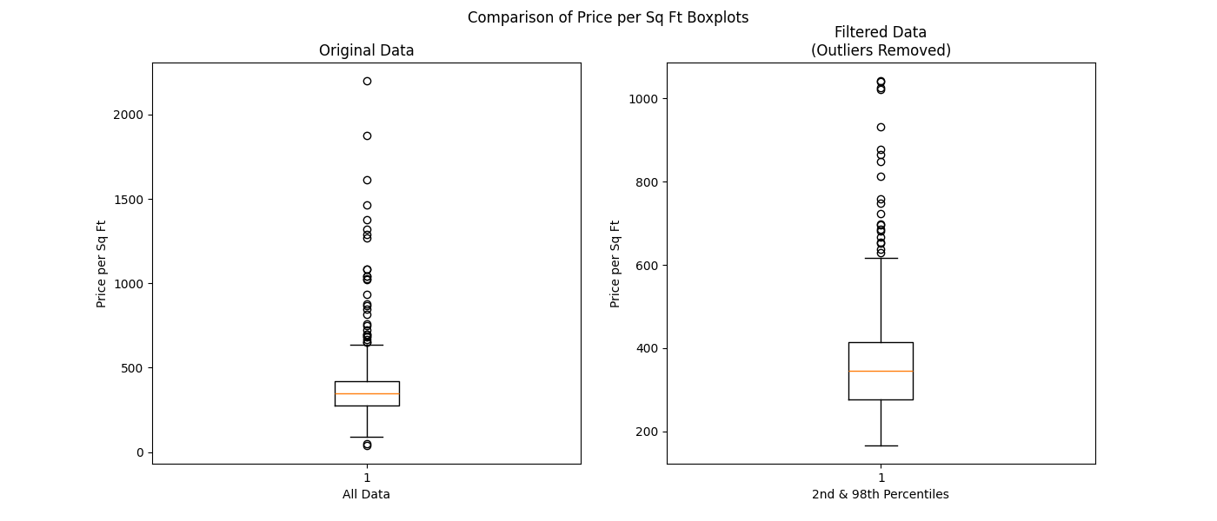
Data Preprocessing
Overall average price per square foot: $383.01

Slide 3
Part 1 Regression: Price Prediction
Dataset | Sample Size | Features
Training Set | 597 | Square Feet, Beds, Baths
Validation Set | 171 | Square Feet, Beds, Baths
Testing Set | 86 | Square Feet, Beds, Baths

Slide 4
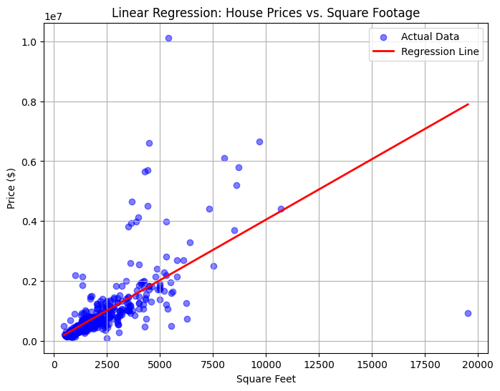
Simple Linear Regression for Price Prediction
Using Square_Feet to predict Price:
W1_hat = 403.95, meaning that for every additional squarefoot, the price of housing is predicted to increase by $403.95
W0_hat = 4,466.44, meaning that when square feet is 0, the predicted price is $4,466.44 which is just a reference point.

Slide 5
Multiple Linear Regression for Price Prediction
According to our model, the intercept (‘base price’) of a house with 0 beds, 0 baths, and 0 square ft would be $19,660
With each additional square foot increase, the price of the house is predicted to increase by $427.18
An increase in bedrooms is predicted to decrease the price of the house by $214,100
More bathrooms leads to a predicted increase in price by $236,100
R^2 tells us that 50.7% of the variation in the prices is due to the variables above.
For a more accurate model we conducted a multiple linear regression to predict house prices taking into account:
Square feet
Number of bedrooms
Number of bathrooms

Slide 6
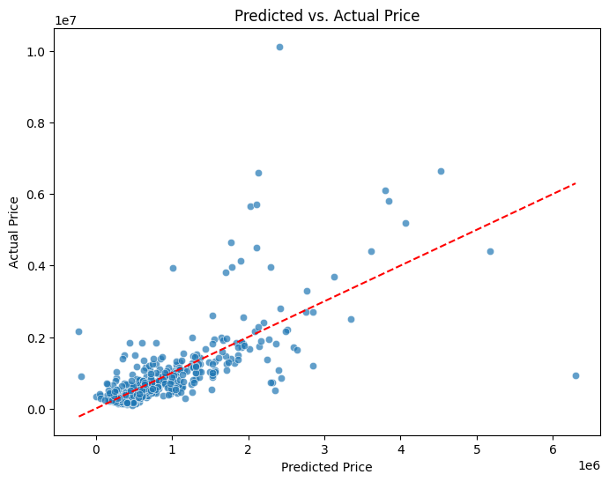
Multiple Linear Regression
Dots indicate the price predictions, the linear line is the prediction line if the model had 100% accuracy.
Proximity to the line = accurate predictions
Deviations from it = there are important factors missing

Slide 7
Improving the Model
To increase our models ability to better predict variance, we need to add more home features that may better predict prices. In our regression we now included:
Property type
Beds
Baths
Square Feet
Lot Size
Year Built
Zip Code
Walk Score, Transit Score, Bike Score
Neighborhood ratings
Observations:
Validation MSE: 356639636611.09436
Test MSE: 2484939633098.1616

Slide 8
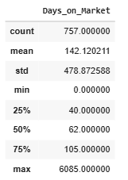
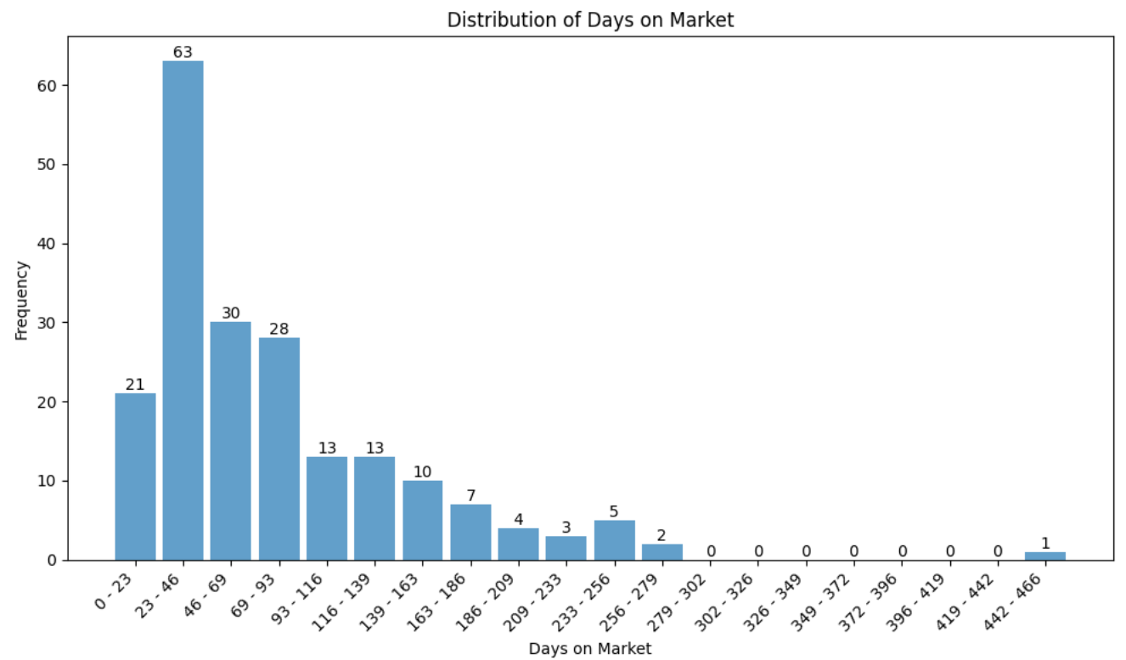
Part 2 Classification: List Price Optimization
First of all, we created a new column called “Days_on_Market” which is calculated by subtracting “Sold_Date” with “List_Date”. A summary of the column “Days_on_Market” is given below and a Histogram depicting the distribution of Days_on_Market.

Slide 9
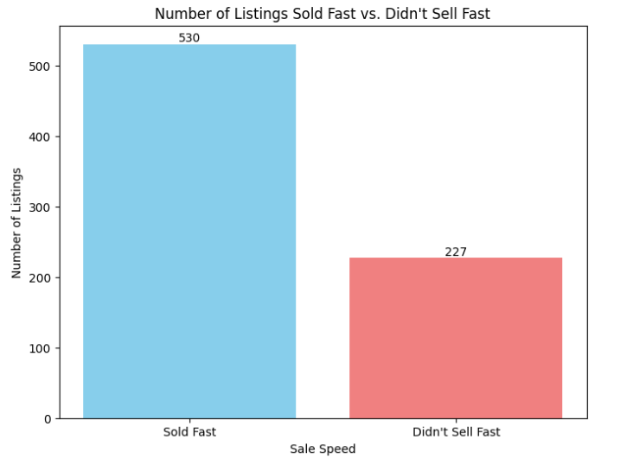
Part 2 Classification: List Price Optimization
Second of all, using the “Days_on_Market” column we created a new column called “Sell Fast” which contains binary data where 1 means the listing sold faster than 70% of all listings and 0 means the listing did not sell faster than 70% of all listings.

Slide 10
Part 2 Classification: List Price Optimization
Dataset | Sample Size
Training Set | 555
Validation Set | 148
Testing Set | 38

Slide 11
Part 2 Classification: Model Performance
Model | Validation Accuracy | Testing Accuracy | Difference between validation and test accuracies
KNN | 72% | 55% | 17%
Logistic Regression | 73% | 76 | 3%
SVM | 73% | 79 | 6%
Decision Tree | 75 | 73 | 2%

Slide 12
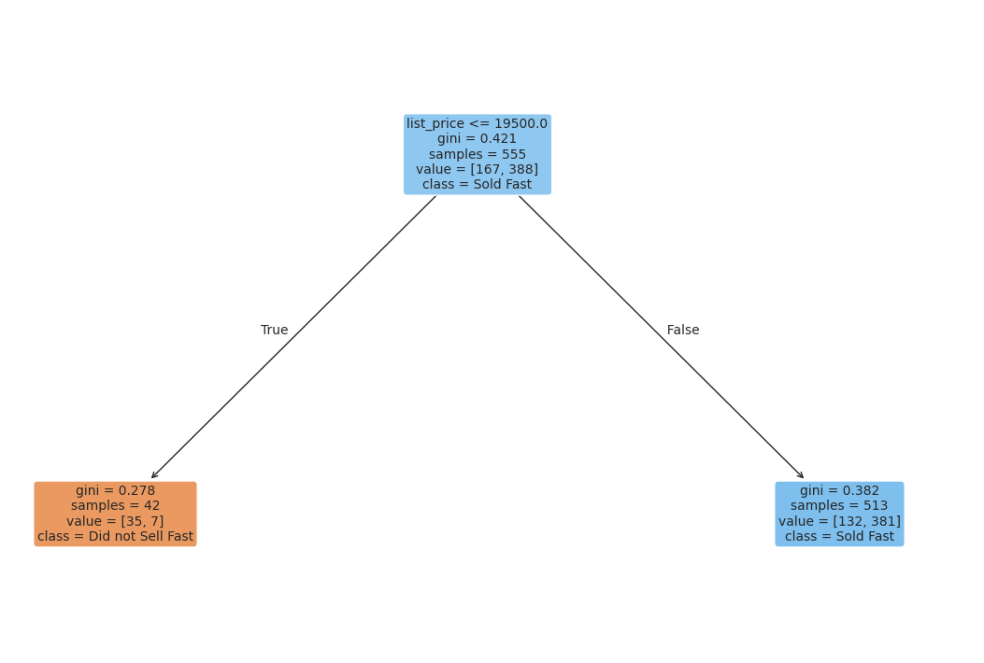
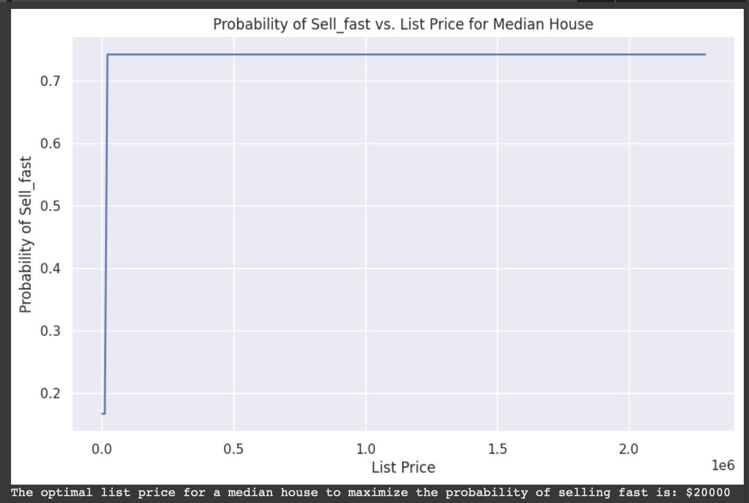
Which model we picked and what does it tell us ?
By observing differences between the Validation and Test Accuracy, we decided to go for the Decision Tree model.
Tree Observation Plot
Plot of optimal value vs probability of it selling fast

Slide 13
What does this optimal price tell us?
The decision tree uses a single threshold around 19,500, so everything below that value falls into one leaf with a high “fast sell” probability, and everything above it falls into another leaf with a lower probability.
Because there are no further splits on list_price, once you cross that threshold, the predicted probability remains constant.
That’s why the plot is essentially a step function: it jumps at 19,500, and beyond 20,000, the model prediction stays the same.

Slide 14
Confounding Variables
How does the performance of the Logistic Regression model change when using scaled features?
Accuracy of the Logistic Regression model actually decreased slightly when the features were scaled (~71%). Scaling did not improve the model's performance in this specific scenario.
How does the class imbalance in the 'Sell_fast' target variable affect the model performance, and what techniques could be used to address it?
There is a slight imbalance in our target variable 'Sell_fast'. The majority class (Sell_fast = 1) has significantly more instances than the minority class (Sell_fast = 0).The imbalance can bias models towards predicting houses that sell fast, requiring techniques like resampling or transformations for better overall performance
1 = 518 | 0 = 208

Slide 15
Appendix
Topic | Slide #
Data Preprocessing | 2
Part 1 Regression: Price Prediction | 3, 4
Multiple Linear Regression for Price Prediction | 5, 6
Improving the Model | 7
Part 2 Classification: List Price Optimization | 8, 9, 10, 11

